Slide 1
Financial Analysis
Hassan ali
01-13232-032

Slide 2
Title and Content Layout with List
Introduction
Inserted line chart from Excel
Overview of key financial metrics and investment strategies

Slide 3
Introduction
Financial analysis is the process of evaluating the financial performance and health of a business or investment.
It involves using various financial metrics and analytical tools to assess the financial position of an organization and make informed decisions based on the results.

Slide 4
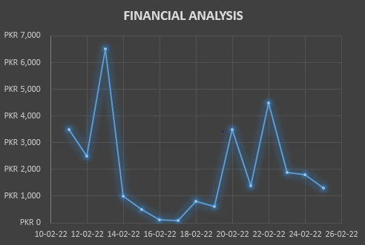
Financial Analysis

Slide 5
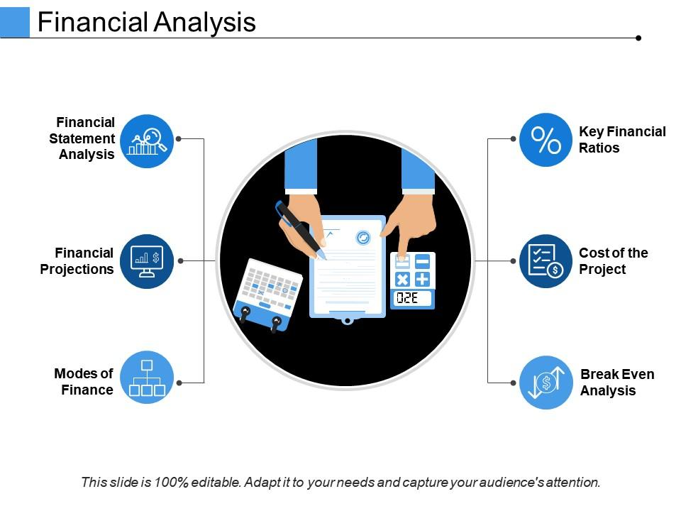
Overview of key financial metrics and investment strategies
Return on Investment (ROI)
Standard Deviation
Notable Trends

